Slide 1

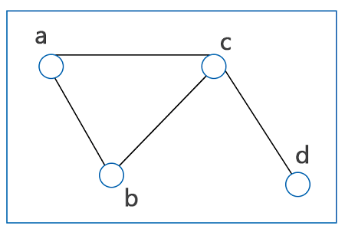

Intro to Graph Theory
Harrison Turner

Slide 2
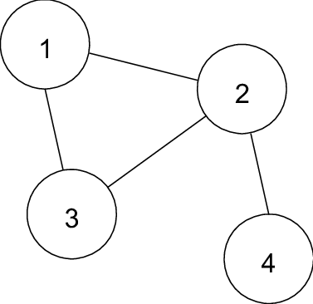

What is a Graph?
The most basic definition for a graph (G) would be an unordered pair of vertices (V) and edges (E) in which each edge connects two distinct vertices and never the same two vertices.
This type of graph is more commonly called an undirected simple graph.
G = (V, E)
The numbers represent the vertices, also called nodes or points, and the edges are the lines that connect them.
Notice how each edge connects two vertices only once.
For instance, V ={1, 2, 3, 4} and E = {1,2},{1,3}, etc.

Slide 3
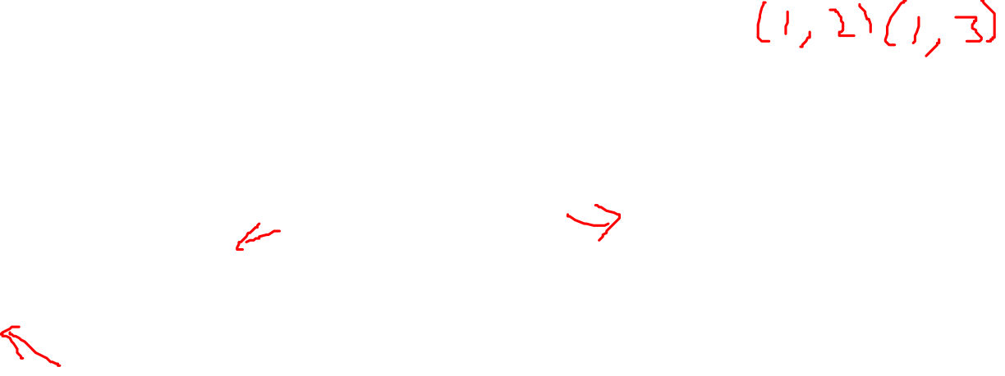



Different types of Graphs
Multigraph – No directed edges. Multiples edges allowed, but no loops allowed.
Pseudograph – No directed edges. Multiple edges and loops allowed.
Simple directed graph – Directed edges, but no multiple edges or loops allowed.
Directed multi graph- Directed and multiple edges allowed, but no loops allowed.
Mixed graph- Everything is allowed.

Slide 4


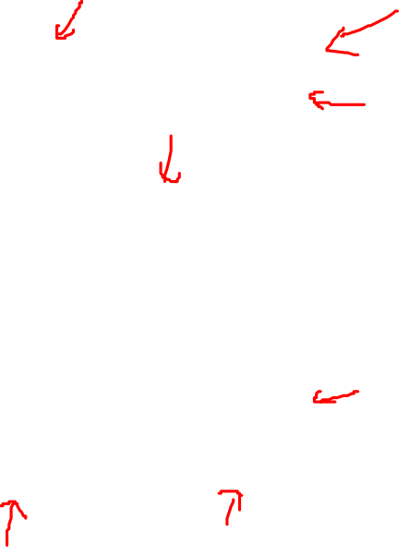

Graph Terminology
Neighbors – adjacent vertices (Neighborhood of (e) are {c, d, f}).
Incident – edge between two vertices (A is incident with vertices c and d).
Degree – amount of edges connected to a given vertex.
Deg (a) = 0, Deg (b) = 1, Deg (f) = 4
Isolated vertex – vertex with no connected edges. (a)
Pendant – a vertex connected with only one edge to
another

Slide 5
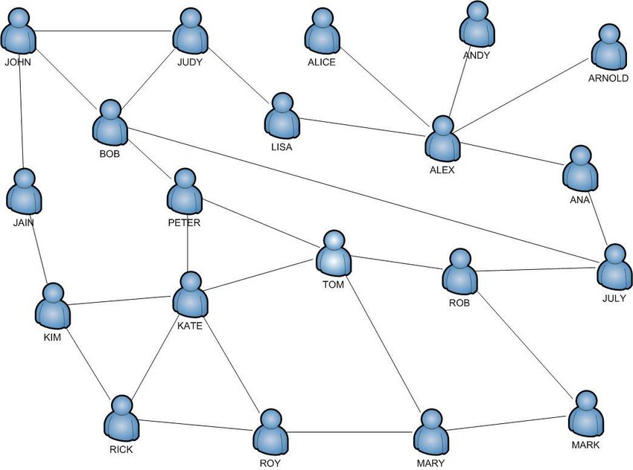
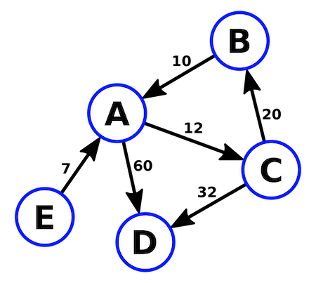
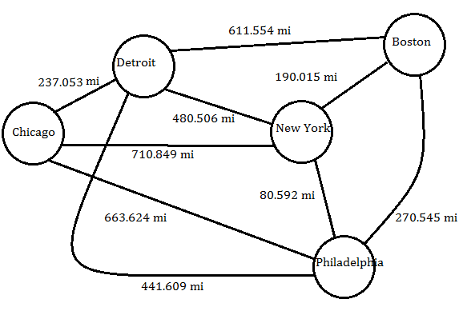
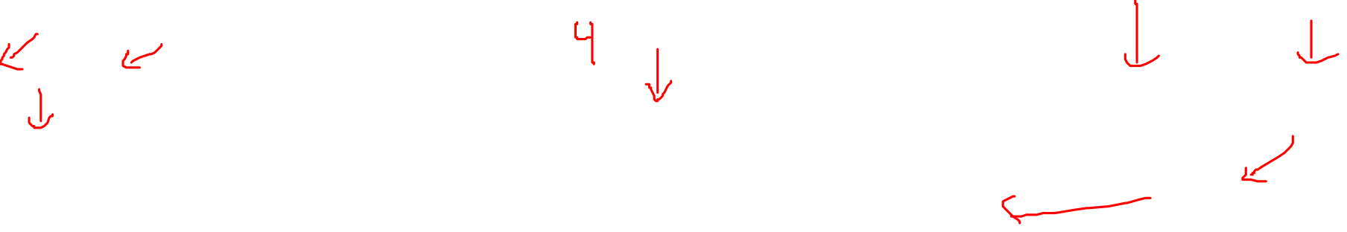
What are the applications?
Social Networks – how to connect friends to mutuals?
Product Recommendations – if someone purchased something what else did they purchase?
Neural Networks – different weights affect an output result.
Road Maps – shortest route in addition to traffic.

